Slide 1
XML Parsing
Lecturer : Jackie Stewart
Email: jackiestewart@ait.ie
jackie.stewart@tus.ie

Slide 2
What is XML Parsing?
Parsing XML refers to going through XML document to access data or to modify data in one or other ways
What is an XML Parser?
XML Parser provides a way to access or modify data present in an XML document.
Java provides multiple options to parse XML document.

Slide 3
Commonly used XML Parsers
Dom Parser
Parses the document by loading the complete contents of the document and creating its complete hierarchical tree in memory.
SAX Parser
Parses the document on event based triggers. Does not load the complete document into the memory.
StAX Parser
Parses the document in similar fashion to SAX parser but in more efficient way.
XML Parser (w3schools.com)

Slide 4
DOM Parser (Document Object Model)

Slide 5
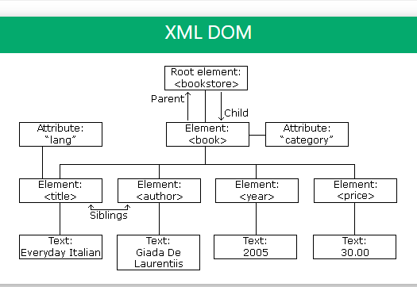
Dom Parser Properties
The whole XML will be loaded into memory
Loads the XML content into a Tree structure
Iterate through the Node and NodeList to get the content of the XML.

Slide 6
Dom Parser
Advantages
you can navigate/read to any node
you can append, delete or update a child node because data is available in the memory.
Disadvantages
if the XML contains a large data, then it will be very expensive memory wise
the whole XML is loaded to memory although you are looking for something particular

Slide 7
When to use a DOM Parser ?
Use DOM parser
when you need to change xml structure
if you are creating a XML document (which is not big!)
BUT typically not to use !
you do not need navigation in the xml
data is huge

Slide 8
SAX Parser (Simple API for XML)

Slide 9
SAX Parser Properties
SAX parser doesn’t load the complete XML into the memory !
It parses the XML line by line
Triggers different events as and when it encounters different elements like: opening tag, closing tag, character data
you can add your event handler depending on your requirements.
so you register a handler (or more then one handler) and those handlers are called when an event occurs.

Slide 10
SAX Parser Properties (contd.)
The DefaultHandler class provides different callbacks:
startElement() – triggers this event when the start of the tag is encountered.
endElement() – triggers this event when the end of the tag is encountered.
characters() – triggers this event when it encounters some text data.

Slide 11
SAX Parser
Advantages
you do not need to worry on memory Consumptions
if the performance is the criteria, (and if you are only reading the xml), SAX is a much better choice then DOM.
Disadvantages
you are not going to have a tree structure where you can require parent or child elements

Slide 12
When to use a SAX Parser
When you do not need navigation in the xml
When the Data is huge

Slide 13
StAX Parser

Slide 14
StAX Parser Properties
StAX does not store anything to memory
StAX looks like parsing with SAX
in SAX, your event handler is called by SAX when an event occurs.
In StAX, you ask StAX to continue to next event
SAX parser issues events as and when certain data is encountered
the “cursor model” in StAX: next event can be required by parser.next()

Slide 15
StAX Parser Properties (contd.)
XMLInputFactory, XMLStreamReader classes are used to load an XML file
We read through the XML file using XMLStreamReader
Events are generated in the form of integer values
These are then compared with the constants in XMLStreamConstants

Slide 16
XML Parsing – a comparison of the three API’s
DOM (Document Object Model) is
Memory intensive
Read-write
Typically used for working with documents smaller than 10 megabytes
SAX (Simple API for XML) is
Memory efficient
Read-only
Typically used for working with documents larger than 10 megabytes
StAX (Streaming API for XML) is
Memory efficient
Read-write
Appropriate for documents of all sizes.
Easier to use than DOM or SAX

